Slide 1
Classification: Basic Concepts and Techniques
Lecture 4

Slide 2
Chapter 8. Classification: Basic Concepts
Classification: Basic Concepts
Decision Tree Induction
Bayes Classification Methods
Rule-Based Classification
Model Evaluation and Selection
Techniques to Improve Classification Accuracy: Ensemble Methods
2
Notes:
2

Slide 3
Supervised vs. Unsupervised Learning
Supervised learning (classification)
Supervision: The training data (observations, measurements, etc.) are accompanied by labels indicating the class of the observations
New data is classified based on the training set
Unsupervised learning (clustering)
The class labels of training data is unknown
Given a set of measurements, observations, etc. with the aim of establishing the existence of classes or clusters in the data

Slide 4
Prediction Problems: Classification vs. Numeric Prediction
Classification
predicts categorical class labels (discrete or nominal)
classifies data (constructs a model) based on the training set and the values (class labels) in a classifying attribute and uses it in classifying new data
Numeric Prediction
models continuous-valued functions, i.e., predicts unknown or missing values
Typical applications
Credit/loan approval:
Medical diagnosis: if a tumor is cancerous or benign
Fraud detection: if a transaction is fraudulent
Web page categorization: which category it is

Slide 5
Classification—A Two-Step Process
Model construction: describing a set of predetermined classes
Each tuple/sample is assumed to belong to a predefined class, as determined by the class label attribute
The set of tuples used for model construction is training set
The model is represented as classification rules, decision trees, or mathematical formulae
Model usage: for classifying future or unknown objects
Estimate accuracy of the model
The known label of test sample is compared with the classified result from the model
Accuracy rate is the percentage of test set samples that are correctly classified by the model
Test set is independent of training set (otherwise overfitting)
If the accuracy is acceptable, use the model to classify new data
Note: If the test set is used to select models, it is called validation (test) set

Slide 6
Process (1): Model Construction
Classification
Algorithms
Training
Data
Classifier
(Model)
IF rank = ‘professor’
OR years > 6
THEN tenured = ‘yes’

Slide 7
Process (2): Using the Model in Prediction
Classifier
Testing
Data
Unseen Data
(Jeff, Professor, 4)
Tenured?

Slide 8
Chapter 8. Classification: Basic Concepts
Classification: Basic Concepts
Decision Tree Induction
Bayes Classification Methods
Rule-Based Classification
Model Evaluation and Selection
Techniques to Improve Classification Accuracy: Ensemble Methods
8
Notes:
8

Slide 9
Decision Tree Induction: An Example
Training data set: Buys_computer
The data set follows an example of Quinlan’s ID3 (Playing Tennis)
Resulting tree:
age?
<=30
overcast
>40
31..40
student?
yes
credit rating?
no
yes
excellent
fair
no
yes
no
yes

Slide 10
Algorithm for Decision Tree Induction
Basic algorithm (a greedy algorithm)
Tree is constructed in a top-down recursive divide-and-conquer manner
At start, all the training examples are at the root
Attributes are categorical (if continuous-valued, they are discretized in advance)
Examples are partitioned recursively based on selected attributes
Test attributes are selected on the basis of a heuristic or statistical measure (e.g., information gain)
Conditions for stopping partitioning
All samples for a given node belong to the same class
There are no remaining attributes for further partitioning – majority voting is employed for classifying the leaf
There are no samples left

Slide 11
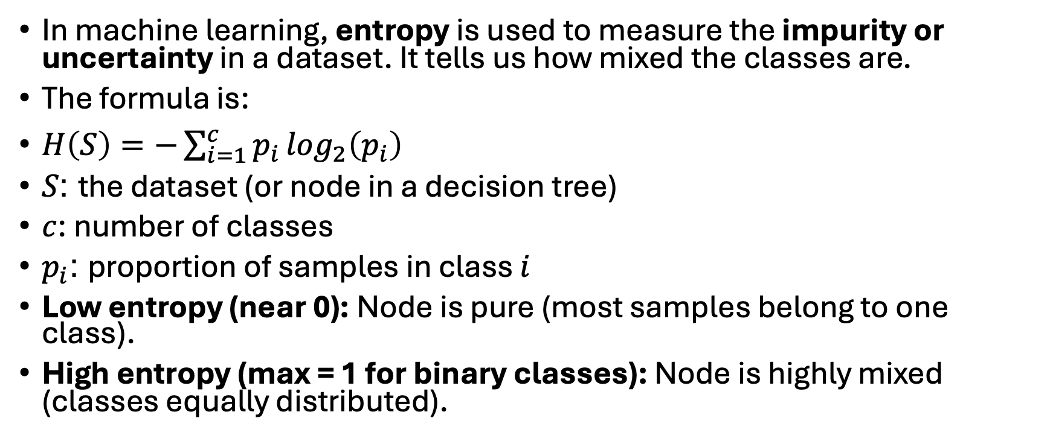
Entropy in Classification (ML Context)
In machine learning, entropy is used to measure the impurity or uncertainty in a dataset. It tells us how mixed the classes are.
The formula is:
$H\left(S\right)=−\sum_{i=1}^{c}{p_{i}}\log_{2}\left(p_{i}\right)$
$S$: the dataset (or node in a decision tree)
$c$: number of classes
$p_{i}$: proportion of samples in class $i$
Low entropy (near 0): Node is pure (most samples belong to one class).
High entropy (max = 1 for binary classes): Node is highly mixed (classes equally distributed).

Slide 12
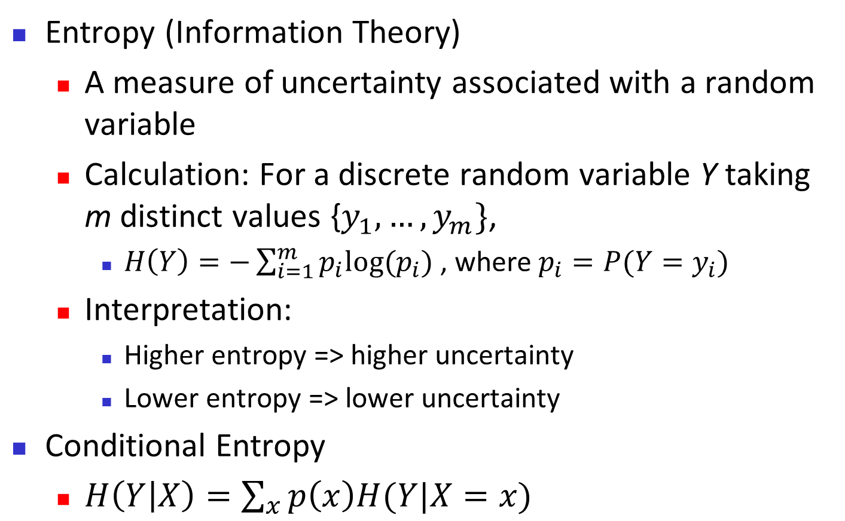
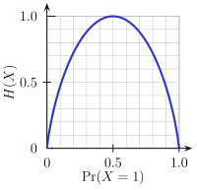
Brief Review of Entropy
m = 2

Slide 13
Attribute Selection Measure: Information Gain (ID3/C4.5)
Select the attribute with the highest information gain
Let p_{i} be the probability that an arbitrary tuple in D belongs to class C_{i}, estimated by |C_{i, D}|/|D|
Expected information (entropy) needed to classify a tuple in D:
Information needed (after using A to split D into v partitions) to classify D:
Information gained by branching on attribute A
Notes:
I : the expected information needed to classify a given sample
E (entropy) : expected information based on the partitioning into subsets by A

Slide 14
ID3 and C4.5 — both are classic decision tree algorithms used in classification machine learning.
ID3 (Iterative Dichotomiser 3)
Developed by Ross Quinlan (1986).
Purpose: Build a decision tree for classification.
Core idea: Uses entropy and information gain to choose the best attribute to split data.
Steps:
Calculate entropy of the dataset.
For each attribute, calculate the information gain.
Choose the attribute with the highest gain to split.
Repeat recursively until all data is classified or no attributes left.
Limitations:
Works only with categorical attributes (not continuous values).
Can overfit training data.
Doesn’t handle missing values well.
C4.5 (Successor to ID3)
Also developed by Ross Quinlan (1993).
Improvement over ID3 to handle practical issues.
Enhancements over ID3:
Works with both categorical and continuous attributes (by finding threshold splits).
Handles missing attribute values gracefully.
Uses Gain Ratio (a modification of information gain) to reduce bias toward attributes with many values.
Pruning: After building the tree, C4.5 prunes branches that don’t add value (helps avoid overfitting).
Can handle larger datasets more efficiently.

Slide 15
Attribute Selection: Information Gain
Class P: buys_computer = “yes”
Class N: buys_computer = “no”
means “age <=30” has 5 out of 14 samples, with 2 yes’es and 3 no’s. Hence
Similarly,

Slide 16
What is Information Gain (IG)?
Information Gain is a measure used in decision tree algorithms (like ID3 and C4.5) to decide which feature to split on.
It tells us how much “uncertainty” (entropy) is reduced after splitting a dataset based on a given attribute.
In short: IG = reduction in entropy after a split.

Slide 17
Computing Information-Gain for Continuous-Valued Attributes
Let attribute A be a continuous-valued attribute
Must determine the best split point for A
Sort the value A in increasing order
Typically, the midpoint between each pair of adjacent values is considered as a possible split point
(a_{i}+a_{i+1})/2 is the midpoint between the values of a_{i} and a_{i+1}
The point with the minimum expected information requirement for A is selected as the split-point for A
Split:
D1 is the set of tuples in D satisfying A ≤ split-point, and D2 is the set of tuples in D satisfying A > split-point

Slide 18
Gain Ratio for Attribute Selection (C4.5)
Information gain measure is biased towards attributes with a large number of values
C4.5 (a successor of ID3) uses gain ratio to overcome the problem (normalization to information gain)
GainRatio(A) = Gain(A)/SplitInfo(A)
Ex.
gain_ratio(income) = 0.029/1.557 = 0.019
The attribute with the maximum gain ratio is selected as the splitting attribute

Slide 19
Gini Index (CART, IBM IntelligentMiner)
If a data set D contains examples from n classes, gini index, gini(D) is defined as
where p_{j} is the relative frequency of class j in D
If a data set D is split on A into two subsets D₁ and D₂, the gini index gini(D) is defined as
Reduction in Impurity:
The attribute provides the smallest gini_{split}(D) (or the largest reduction in impurity) is chosen to split the node (need to enumerate all the possible splitting points for each attribute)

Slide 20
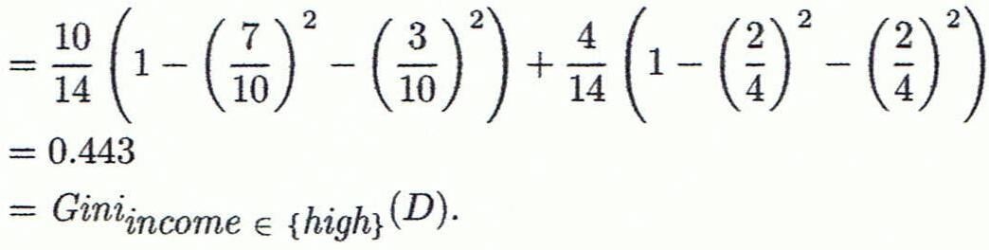
Computation of Gini Index
Ex. D has 9 tuples in buys_computer = “yes” and 5 in “no”
Suppose the attribute income partitions D into 10 in D₁: {low, medium} and 4 in D₂
Gini_{{low,high}} is 0.458; Gini_{{medium,high}} is 0.450. Thus, split on the {low,medium} (and {high}) since it has the lowest Gini index
All attributes are assumed continuous-valued
May need other tools, e.g., clustering, to get the possible split values
Can be modified for categorical attributes

Slide 21
Comparing Attribute Selection Measures
The three measures, in general, return good results but
Information gain:
biased towards multivalued attributes
Gain ratio:
tends to prefer unbalanced splits in which one partition is much smaller than the others
Gini index:
biased to multivalued attributes
has difficulty when # of classes is large
tends to favor tests that result in equal-sized partitions and purity in both partitions

Slide 22
Other Attribute Selection Measures
CHAID: a popular decision tree algorithm, measure based on χ² test for independence
C-SEP: performs better than info. gain and gini index in certain cases
G-statistic: has a close approximation to χ² distribution
MDL (Minimal Description Length) principle (i.e., the simplest solution is preferred):
The best tree as the one that requires the fewest # of bits to both (1) encode the tree, and (2) encode the exceptions to the tree
Multivariate splits (partition based on multiple variable combinations)
CART: finds multivariate splits based on a linear comb. of attrs.
Which attribute selection measure is the best?
Most give good results, none is significantly superior than others

Slide 23
Overfitting and Tree Pruning
Overfitting: An induced tree may overfit the training data
Too many branches, some may reflect anomalies due to noise or outliers
Poor accuracy for unseen samples
Two approaches to avoid overfitting
Prepruning: Halt tree construction early ̵ do not split a node if this would result in the goodness measure falling below a threshold
Difficult to choose an appropriate threshold
Postpruning: Remove branches from a “fully grown” tree—get a sequence of progressively pruned trees
Use a set of data different from the training data to decide which is the “best pruned tree”

Slide 24
Enhancements to Basic Decision Tree Induction
Allow for continuous-valued attributes
Dynamically define new discrete-valued attributes that partition the continuous attribute value into a discrete set of intervals
Handle missing attribute values
Assign the most common value of the attribute
Assign probability to each of the possible values
Attribute construction
Create new attributes based on existing ones that are sparsely represented
This reduces fragmentation, repetition, and replication

Slide 25
Classification in Large Databases
Classification—a classical problem extensively studied by statisticians and machine learning researchers
Scalability: Classifying data sets with millions of examples and hundreds of attributes with reasonable speed
Why is decision tree induction popular?
relatively faster learning speed (than other classification methods)
convertible to simple and easy to understand classification rules
can use SQL queries for accessing databases
comparable classification accuracy with other methods
RainForest (VLDB’98 — Gehrke, Ramakrishnan & Ganti)
Builds an AVC-list (attribute, value, class label)

Slide 26
Chapter 8. Classification: Basic Concepts
Classification: Basic Concepts
Decision Tree Induction
Bayes Classification Methods
Rule-Based Classification
Model Evaluation and Selection
Techniques to Improve Classification Accuracy: Ensemble Methods
26
Notes:
26

Slide 27
Bayesian Classification: Why?
A statistical classifier: performs probabilistic prediction, i.e., predicts class membership probabilities
Foundation: Based on Bayes’ Theorem.
Performance: A simple Bayesian classifier, naïve Bayesian classifier, has comparable performance with decision tree and selected neural network classifiers
Incremental: Each training example can incrementally increase/decrease the probability that a hypothesis is correct — prior knowledge can be combined with observed data
Standard: Even when Bayesian methods are computationally intractable, they can provide a standard of optimal decision making against which other methods can be measured

Slide 28
Bayes’ Theorem: Basics
Total probability Theorem:
Bayes’ Theorem:
Let X be a data sample (“evidence”): class label is unknown
Let H be a hypothesis that X belongs to class C
Classification is to determine P(H|X), (i.e., posteriori probability): the probability that the hypothesis holds given the observed data sample X
P(H) (prior probability): the initial probability
E.g., X will buy computer, regardless of age, income, …
P(X): probability that sample data is observed
P(X|H) (likelihood): the probability of observing the sample X, given that the hypothesis holds
E.g., Given that X will buy computer, the prob. that X is 31..40, medium income

Slide 29
Prediction Based on Bayes’ Theorem
Given training data X, posteriori probability of a hypothesis H, P(H|X), follows the Bayes’ theorem
Informally, this can be viewed as
posteriori = likelihood x prior/evidence
Predicts X belongs to C_{i} iff the probability P(C_{i}|X) is the highest among all the P(C_{k}|X) for all the k classes
Practical difficulty: It requires initial knowledge of many probabilities, involving significant computational cost

Slide 30
Classification Is to Derive the Maximum Posteriori
Let D be a training set of tuples and their associated class labels, and each tuple is represented by an n-D attribute vector X = (x₁, x₂, …, x_{n})
Suppose there are m classes C₁, C₂, …, C_{m}.
Classification is to derive the maximum posteriori, i.e., the maximal P(C_{i}|X)
This can be derived from Bayes’ theorem
Since P(X) is constant for all classes, only
needs to be maximized

Slide 31
Naïve Bayes Classifier
A simplified assumption: attributes are conditionally independent (i.e., no dependence relation between attributes):
This greatly reduces the computation cost: Only counts the class distribution
If A_{k} is categorical, P(x_{k}|C_{i}) is the # of tuples in C_{i} having value x_{k} for A_{k} divided by |C_{i, D}| (# of tuples of C_{i} in D)
If A_{k} is continous-valued, P(x_{k}|C_{i}) is usually computed based on Gaussian distribution with a mean μ and standard deviation σ
and P(x_{k}|C_{i}) is

Slide 32
Naïve Bayes Classifier: Training Dataset
Class:
C1:buys_computer = ‘yes’
C2:buys_computer = ‘no’
Data to be classified:
X = (age <=30,
Income = medium,
Student = yes
Credit_rating = Fair)

Slide 33
Naïve Bayes Classifier: An Example
P(C_{i}): P(buys_computer = “yes”) = 9/14 = 0.643
P(buys_computer = “no”) = 5/14= 0.357
Compute P(X|C_{i}) for each class
P(age = “<=30” | buys_computer = “yes”) = 2/9 = 0.222
P(age = “<= 30” | buys_computer = “no”) = 3/5 = 0.6
P(income = “medium” | buys_computer = “yes”) = 4/9 = 0.444
P(income = “medium” | buys_computer = “no”) = 2/5 = 0.4
P(student = “yes” | buys_computer = “yes) = 6/9 = 0.667
P(student = “yes” | buys_computer = “no”) = 1/5 = 0.2
P(credit_rating = “fair” | buys_computer = “yes”) = 6/9 = 0.667
P(credit_rating = “fair” | buys_computer = “no”) = 2/5 = 0.4
X = (age <= 30 , income = medium, student = yes, credit_rating = fair)
P(X|C_{i}) : P(X|buys_computer = “yes”) = 0.222 x 0.444 x 0.667 x 0.667 = 0.044
P(X|buys_computer = “no”) = 0.6 x 0.4 x 0.2 x 0.4 = 0.019
P(X|C_{i})*P(C_{i}) : P(X|buys_computer = “yes”) * P(buys_computer = “yes”) = 0.028
P(X|buys_computer = “no”) * P(buys_computer = “no”) = 0.007
Therefore, X belongs to class (“buys_computer = yes”)

Slide 34
Avoiding the Zero-Probability Problem
Naïve Bayesian prediction requires each conditional prob. be non-zero. Otherwise, the predicted prob. will be zero
Ex. Suppose a dataset with 1000 tuples, income=low (0), income= medium (990), and income = high (10)
Use Laplacian correction (or Laplacian estimator)
Adding 1 to each case
Prob(income = low) = 1/1003
Prob(income = medium) = 991/1003
Prob(income = high) = 11/1003
The “corrected” prob. estimates are close to their “uncorrected” counterparts

Slide 35
Naïve Bayes Classifier: Comments
Advantages
Easy to implement
Good results obtained in most of the cases
Disadvantages
Assumption: class conditional independence, therefore loss of accuracy
Practically, dependencies exist among variables
E.g., hospitals: patients: Profile: age, family history, etc.
Symptoms: fever, cough etc., Disease: lung cancer, diabetes, etc.
Dependencies among these cannot be modeled by Naïve Bayes Classifier
How to deal with these dependencies? Bayesian Belief Networks (Chapter 9)

Slide 36
Chapter 8. Classification: Basic Concepts
Classification: Basic Concepts
Decision Tree Induction
Bayes Classification Methods
Rule-Based Classification
Model Evaluation and Selection
Techniques to Improve Classification Accuracy: Ensemble Methods
36
Notes:
36

Slide 37
Using IF-THEN Rules for Classification
Represent the knowledge in the form of IF-THEN rules
R: IF age = youth AND student = yes THEN buys_computer = yes
Rule antecedent/precondition vs. rule consequent
Assessment of a rule: coverage and accuracy
n_{covers} = # of tuples covered by R
n_{correct} = # of tuples correctly classified by R
coverage(R) = n_{covers} /|D| /* D: training data set */
accuracy(R) = n_{correct} / n_{covers}
If more than one rule are triggered, need conflict resolution
Size ordering: assign the highest priority to the triggering rules that has the “toughest” requirement (i.e., with the most attribute tests)
Class-based ordering: decreasing order of prevalence or misclassification cost per class
Rule-based ordering (decision list): rules are organized into one long priority list, according to some measure of rule quality or by experts

Slide 38
Rule Extraction from a Decision Tree
Rules are easier to understand than large trees
One rule is created for each path from the root to a leaf
Each attribute-value pair along a path forms a conjunction: the leaf holds the class prediction
Rules are mutually exclusive and exhaustive
age?
<=30
31..40
>40
student?
yes
credit rating?
no
yes
excellent
fair
no
yes
no
yes
Example: Rule extraction from our buys_computer decision-tree
IF age = young AND student = no THEN buys_computer = no
IF age = young AND student = yes THEN buys_computer = yes
IF age = mid-age THEN buys_computer = yes
IF age = old AND credit_rating = excellent THEN buys_computer = no
IF age = old AND credit_rating = fair THEN buys_computer = yes

Slide 39
Rule Induction: Sequential Covering Method
Sequential covering algorithm: Extracts rules directly from training data
Typical sequential covering algorithms: FOIL, AQ, CN2, RIPPER
Rules are learned sequentially, each for a given class C_{i} will cover many tuples of C_{i} but none (or few) of the tuples of other classes
Steps:
Rules are learned one at a time
Each time a rule is learned, the tuples covered by the rules are removed
Repeat the process on the remaining tuples until termination condition, e.g., when no more training examples or when the quality of a rule returned is below a user-specified threshold
Comp. w. decision-tree induction: learning a set of rules simultaneously

Slide 40
Sequential Covering Algorithm
while (enough target tuples left)
generate a rule
remove positive target tuples satisfying this rule
Examples covered
by Rule 2
Examples covered
by Rule 1
Examples covered
by Rule 3
Positive examples

Slide 41
Rule Generation
To generate a rule
while(true)
find the best predicate p
if foil-gain(p) > threshold then add p to current rule
else break
A3=1
A3=1&&A1=2
A3=1&&A1=2
&&A8=5
Positive examples
Negative examples

Slide 42
How to Learn-One-Rule?
Start with the most general rule possible: condition = empty
Adding new attributes by adopting a greedy depth-first strategy
Picks the one that most improves the rule quality
Rule-Quality measures: consider both coverage and accuracy
Foil-gain (in FOIL & RIPPER): assesses info_gain by extending condition
favors rules that have high accuracy and cover many positive tuples
Rule pruning based on an independent set of test tuples
Pos/neg are # of positive/negative tuples covered by R.
If FOIL_Prune is higher for the pruned version of R, prune R

Slide 43
Chapter 8. Classification: Basic Concepts
Classification: Basic Concepts
Decision Tree Induction
Bayes Classification Methods
Rule-Based Classification
Model Evaluation and Selection
Techniques to Improve Classification Accuracy: Ensemble Methods
43
Notes:
43

Slide 44
Model Evaluation and Selection
Evaluation metrics: How can we measure accuracy? Other metrics to consider?
Use validation test set of class-labeled tuples instead of training set when assessing accuracy
Methods for estimating a classifier’s accuracy:
Holdout method, random subsampling
Cross-validation
Bootstrap
Comparing classifiers:
Confidence intervals
Cost-benefit analysis and ROC Curves
44

Slide 45
Classifier Evaluation Metrics: Confusion Matrix
Confusion Matrix:
Actual class\Predicted class | C₁ | ¬ C₁
C₁ | True Positives (TP) | False Negatives (FN)
¬ C₁ | False Positives (FP) | True Negatives (TN)
Example of Confusion Matrix:
Actual class\Predicted class | buy_computer = yes | buy_computer = no | Total
buy_computer = yes | 6954 | 46 | 7000
buy_computer = no | 412 | 2588 | 3000
Total | 7366 | 2634 | 10000
Given m classes, an entry, CM_{i,j} in a confusion matrix indicates # of tuples in class i that were labeled by the classifier as class j
May have extra rows/columns to provide totals
45

Slide 46
Classifier Evaluation Metrics: Accuracy, Error Rate, Sensitivity and Specificity
A\P | C | ¬C
C | TP | FN | P
¬C | FP | TN | N
 | P’ | N’ | All
Class Imbalance Problem:
One class may be rare, e.g. fraud, or HIV-positive
Significant majority of the negative class and minority of the positive class
Sensitivity: True Positive recognition rate
Sensitivity = TP/P
Specificity: True Negative recognition rate
Specificity = TN/N
Classifier Accuracy, or recognition rate: percentage of test set tuples that are correctly classified
Accuracy = (TP + TN)/All
Error rate: 1 – accuracy, or
Error rate = (FP + FN)/All
46

Slide 47
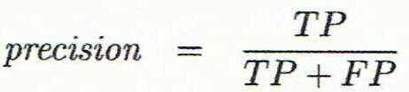
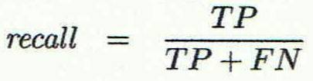
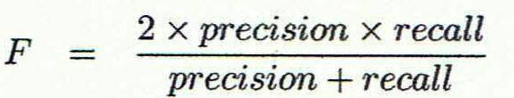
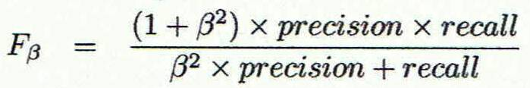
Classifier Evaluation Metrics: Precision and Recall, and F-measures
Precision: exactness – what % of tuples that the classifier labeled as positive are actually positive
Recall: completeness – what % of positive tuples did the classifier label as positive?
Perfect score is 1.0
Inverse relationship between precision & recall
F measure (F₁ or F-score): harmonic mean of precision and recall,
F_{ß}: weighted measure of precision and recall
assigns ß times as much weight to recall as to precision
47

Slide 48
Classifier Evaluation Metrics: Example
Actual Class\Predicted class | cancer = yes | cancer = no | Total | Recognition(%)
cancer = yes | 90 | 210 | 300 | 30.00 (sensitivity
cancer = no | 140 | 9560 | 9700 | 98.56 (specificity)
Total | 230 | 9770 | 10000 | 96.40 (accuracy)
Precision = 90/230 = 39.13% Recall = 90/300 = 30.00%
48

Slide 49
Evaluating Classifier Accuracy: Holdout & Cross-Validation Methods
Holdout method
Given data is randomly partitioned into two independent sets
Training set (e.g., 2/3) for model construction
Test set (e.g., 1/3) for accuracy estimation
Random sampling: a variation of holdout
Repeat holdout k times, accuracy = avg. of the accuracies obtained
Cross-validation (k-fold, where k = 10 is most popular)
Randomly partition the data into k mutually exclusive subsets, each approximately equal size
At i-th iteration, use D_{i} as test set and others as training set
Leave-one-out: k folds where k = # of tuples, for small sized data
*Stratified cross-validation*: folds are stratified so that class dist. in each fold is approx. the same as that in the initial data
49

Slide 50

Evaluating Classifier Accuracy: Bootstrap
Bootstrap
Works well with small data sets
Samples the given training tuples uniformly with replacement
i.e., each time a tuple is selected, it is equally likely to be selected again and re-added to the training set
Several bootstrap methods, and a common one is .632 boostrap
A data set with d tuples is sampled d times, with replacement, resulting in a training set of d samples. The data tuples that did not make it into the training set end up forming the test set. About 63.2% of the original data end up in the bootstrap, and the remaining 36.8% form the test set (since (1 – 1/d)^{d} ≈ e⁻¹ = 0.368)
Repeat the sampling procedure k times, overall accuracy of the model:
50

Slide 51


Estimating Confidence Intervals: Classifier Models M₁ vs. M₂
Suppose we have 2 classifiers, M₁ and M₂, which one is better?
Use 10-fold cross-validation to obtain and
These mean error rates are just estimates of error on the true population of future data cases
What if the difference between the 2 error rates is just attributed to chance?
Use a test of statistical significance
Obtain confidence limits for our error estimates
51

Slide 52
Estimating Confidence Intervals: Null Hypothesis
Perform 10-fold cross-validation
Assume samples follow a t distribution with k–1 degrees of freedom (here, k=10)
Use t-test (or Student’s t-test)
Null Hypothesis: M₁ & M₂ are the same
If we can reject null hypothesis, then
we conclude that the difference between M₁ & M₂ is statistically significant
Chose model with lower error rate
52

Slide 53
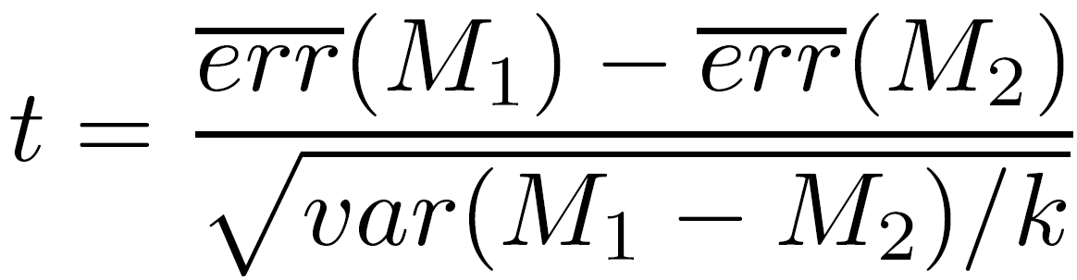
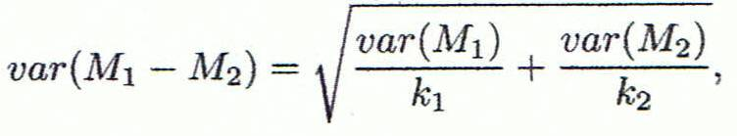
Estimating Confidence Intervals: t-test
If only 1 test set available: pairwise comparison
For i^{th} round of 10-fold cross-validation, the same cross partitioning is used to obtain err(M₁)_{i} and err(M₂)_{i}
Average over 10 rounds to get
t-test computes t-statistic with k-1 degrees of freedom:
If two test sets available: use non-paired t-test
and
where
where
where k₁ & k₂ are # of cross-validation samples used for M₁ & M₂, resp.
53

Slide 54
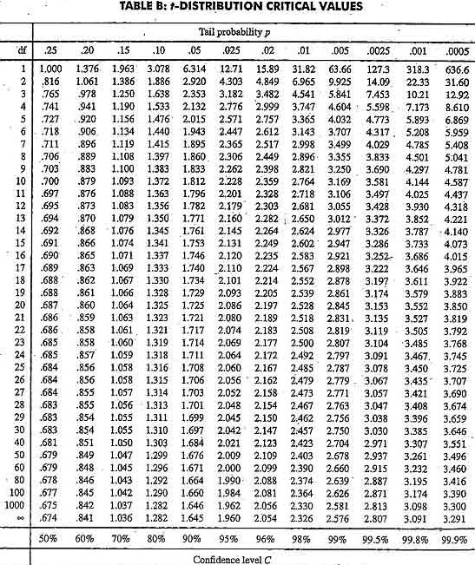
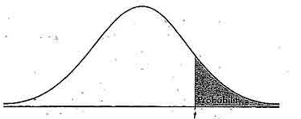
Estimating Confidence Intervals: Table for t-distribution
Symmetric
Significance level, e.g., sig = 0.05 or 5% means M₁ & M₂ are significantly different for 95% of population
Confidence limit, z = sig/2
54

Slide 55
Estimating Confidence Intervals: Statistical Significance
Are M₁ & M₂ significantly different?
Compute t. Select significance level (e.g. sig = 5%)
Consult table for t-distribution: Find t value corresponding to k-1 degrees of freedom (here, 9)
t-distribution is symmetric: typically upper % points of distribution shown → look up value for confidence limit z=sig/2 (here, 0.025)
If t > z or t < -z, then t value lies in rejection region:
Reject null hypothesis that mean error rates of M₁ & M₂ are same
Conclude: statistically significant difference between M₁ & M₂
Otherwise, conclude that any difference is chance
55

Slide 56
Model Selection: ROC Curves
ROC (Receiver Operating Characteristics) curves: for visual comparison of classification models
Originated from signal detection theory
Shows the trade-off between the true positive rate and the false positive rate
The area under the ROC curve is a measure of the accuracy of the model
Rank the test tuples in decreasing order: the one that is most likely to belong to the positive class appears at the top of the list
The closer to the diagonal line (i.e., the closer the area is to 0.5), the less accurate is the model
Vertical axis represents the true positive rate
Horizontal axis rep. the false positive rate
The plot also shows a diagonal line
A model with perfect accuracy will have an area of 1.0
56

Slide 57
Issues Affecting Model Selection
Accuracy
classifier accuracy: predicting class label
Speed
time to construct the model (training time)
time to use the model (classification/prediction time)
Robustness: handling noise and missing values
Scalability: efficiency in disk-resident databases
Interpretability
understanding and insight provided by the model
Other measures, e.g., goodness of rules, such as decision tree size or compactness of classification rules
57
Notes:
57

Slide 58
Chapter 8. Classification: Basic Concepts
Classification: Basic Concepts
Decision Tree Induction
Bayes Classification Methods
Rule-Based Classification
Model Evaluation and Selection
Techniques to Improve Classification Accuracy: Ensemble Methods
58
Notes:
58

Slide 59
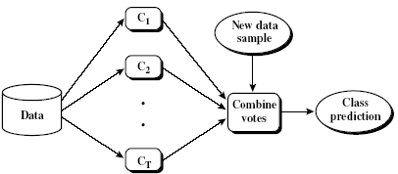
Ensemble Methods: Increasing the Accuracy
Ensemble methods
Use a combination of models to increase accuracy
Combine a series of k learned models, M₁, M₂, …, M_{k}, with the aim of creating an improved model M*
Popular ensemble methods
Bagging: averaging the prediction over a collection of classifiers
Boosting: weighted vote with a collection of classifiers
Ensemble: combining a set of heterogeneous classifiers
59

Slide 60
Bagging: Boostrap Aggregation
Analogy: Diagnosis based on multiple doctors’ majority vote
Training
Given a set D of d tuples, at each iteration i, a training set D_{i} of d tuples is sampled with replacement from D (i.e., bootstrap)
A classifier model M_{i} is learned for each training set D_{i}
Classification: classify an unknown sample X
Each classifier M_{i} returns its class prediction
The bagged classifier M* counts the votes and assigns the class with the most votes to X
Prediction: can be applied to the prediction of continuous values by taking the average value of each prediction for a given test tuple
Accuracy
Often significantly better than a single classifier derived from D
For noise data: not considerably worse, more robust
Proved improved accuracy in prediction
60

Slide 61
Boosting
Analogy: Consult several doctors, based on a combination of weighted diagnoses—weight assigned based on the previous diagnosis accuracy
How boosting works?
Weights are assigned to each training tuple
A series of k classifiers is iteratively learned
After a classifier M_{i} is learned, the weights are updated to allow the subsequent classifier, M_{i+1}, to pay more attention to the training tuples that were misclassified by M_{i}
The final M* combines the votes of each individual classifier, where the weight of each classifier's vote is a function of its accuracy
Boosting algorithm can be extended for numeric prediction
Comparing with bagging: Boosting tends to have greater accuracy, but it also risks overfitting the model to misclassified data
61

Slide 62
Adaboost (Freund and Schapire, 1997)
Given a set of d class-labeled tuples, (X₁, y₁), …, (X_{d}, y_{d})
Initially, all the weights of tuples are set the same (1/d)
Generate k classifiers in k rounds. At round i,
Tuples from D are sampled (with replacement) to form a training set D_{i} of the same size
Each tuple’s chance of being selected is based on its weight
A classification model M_{i} is derived from D_{i}
Its error rate is calculated using D_{i} as a test set
If a tuple is misclassified, its weight is increased, o.w. it is decreased
Error rate: err(X_{j}) is the misclassification error of tuple X_{j}. Classifier M_{i} error rate is the sum of the weights of the misclassified tuples:
The weight of classifier M_{i}’s vote is

Slide 63
Random Forest (Breiman 2001)
Random Forest:
Each classifier in the ensemble is a decision tree classifier and is generated using a random selection of attributes at each node to determine the split
During classification, each tree votes and the most popular class is returned
Two Methods to construct Random Forest:
Forest-RI (random input selection): Randomly select, at each node, F attributes as candidates for the split at the node. The CART methodology is used to grow the trees to maximum size
Forest-RC (random linear combinations): Creates new attributes (or features) that are a linear combination of the existing attributes (reduces the correlation between individual classifiers)
Comparable in accuracy to Adaboost, but more robust to errors and outliers
Insensitive to the number of attributes selected for consideration at each split, and faster than bagging or boosting
63

Slide 64
Classification of Class-Imbalanced Data Sets
Class-imbalance problem: Rare positive example but numerous negative ones, e.g., medical diagnosis, fraud, oil-spill, fault, etc.
Traditional methods assume a balanced distribution of classes and equal error costs: not suitable for class-imbalanced data
Typical methods for imbalance data in 2-class classification:
Oversampling: re-sampling of data from positive class
Under-sampling: randomly eliminate tuples from negative class
Threshold-moving: moves the decision threshold, t, so that the rare class tuples are easier to classify, and hence, less chance of costly false negative errors
Ensemble techniques: Ensemble multiple classifiers introduced above
Still difficult for class imbalance problem on multiclass tasks
64

Slide 65
Classification Errors
Training errors: Errors committed on the training set
Test errors: Errors committed on the test set
Generalization errors: Expected error of a model over random selection of records from same distribution

Slide 66
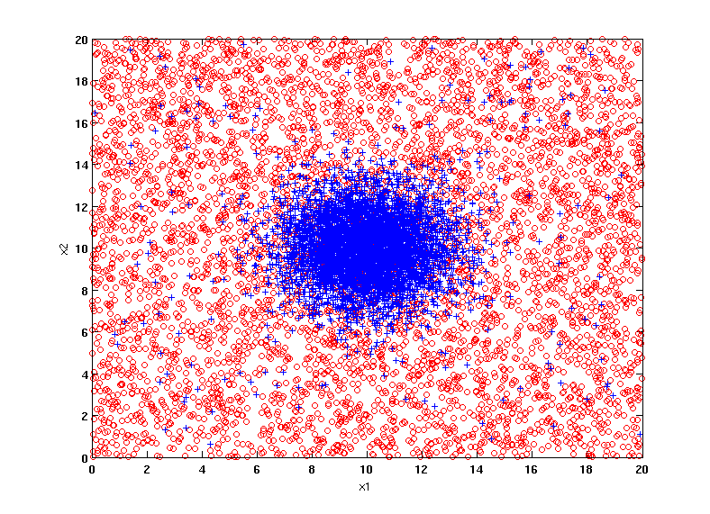
Example Data Set
Two class problem:
+ : 5400 instances
5000 instances generated from a Gaussian centered at (10,10)
400 noisy instances added
o : 5400 instances
Generated from a uniform distribution
10 % of the data used for training and 90% of the data used for testing

Slide 67
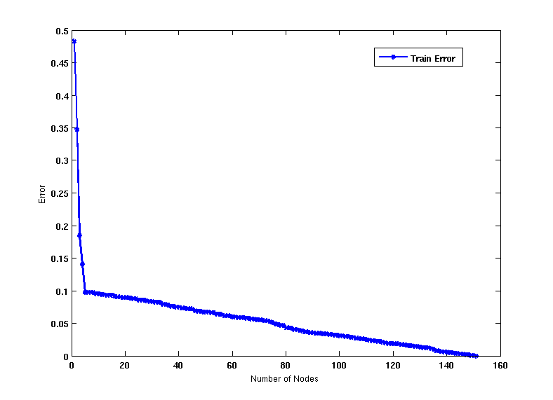
Increasing number of nodes in Decision Trees

Slide 68
Decision Tree with 4 nodes
Decision Tree
Decision boundaries on Training data

Slide 69
Decision Tree with 50 nodes
Decision Tree
Decision Tree
Decision boundaries on Training data

Slide 70
Which tree is better?
Decision Tree with 4 nodes
Which tree is better ?
Decision Tree with 50 nodes

Slide 71
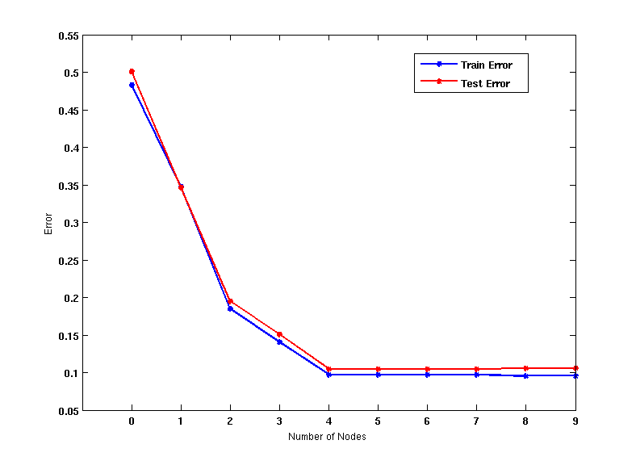
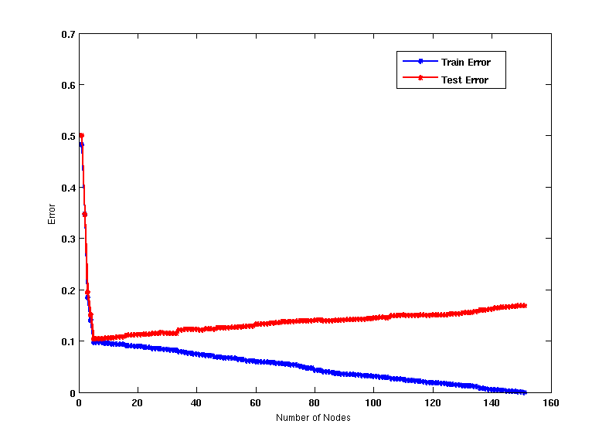
Model Underfitting and Overfitting
As the model becomes more and more complex, test errors can start increasing even though training error may be decreasing
Underfitting: when model is too simple, both training and test errors are large
Overfitting: when model is too complex, training error is small but test error is large

Slide 72
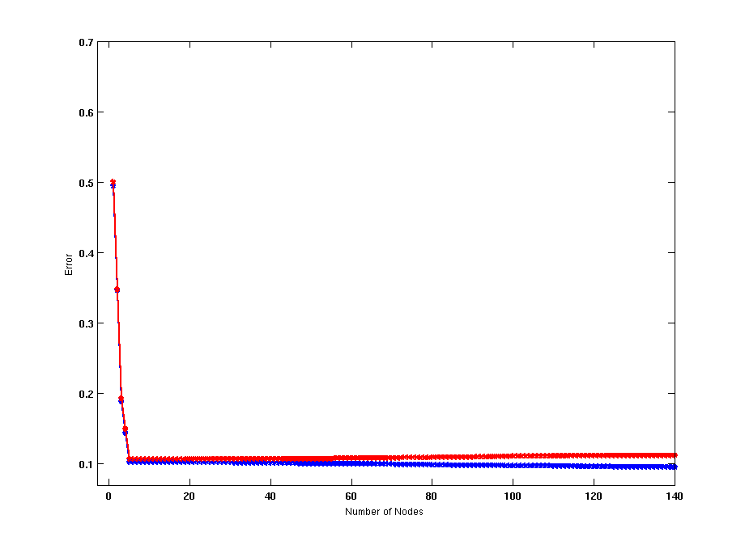
Model Overfitting – Impact of Training Data Size
Using twice the number of data instances
Increasing the size of training data reduces the difference between training and testing errors at a given size of model

Slide 73
Model Overfitting – Impact of Training Data Size
Decision Tree with 50 nodes
Decision Tree with 50 nodes
Using twice the number of data instances
Increasing the size of training data reduces the difference between training and testing errors at a given size of model

Slide 74
Reasons for Model Overfitting
Not enough training data
High model complexity
Multiple Comparison Procedure

Slide 75
Effect of Multiple Comparison Procedure
Consider the task of predicting whether stock market will rise/fall in the next 10 trading days
Random guessing:
P(correct) = 0.5
Make 10 random guesses in a row:
Day 1 | Up
Day 2 | Down
Day 3 | Down
Day 4 | Up
Day 5 | Down
Day 6 | Down
Day 7 | Up
Day 8 | Up
Day 9 | Up
Day 10 | Down

Slide 76
Effect of Multiple Comparison Procedure
Approach:
Get 50 analysts
Each analyst makes 10 random guesses
Choose the analyst that makes the most number of correct predictions
Probability that at least one analyst makes at least 8 correct predictions

Slide 77
Effect of Multiple Comparison Procedure
Many algorithms employ the following greedy strategy:
Initial model: M
Alternative model: M’ = M ∪ γ, where γ is a component to be added to the model (e.g., a test condition of a decision tree)
Keep M’ if improvement, Δ(M,M’) > α
Often times, γ is chosen from a set of alternative components, Γ = {γ₁, γ₂, …, γ_{k}}
If many alternatives are available, one may inadvertently add irrelevant components to the model, resulting in model overfitting

Slide 78
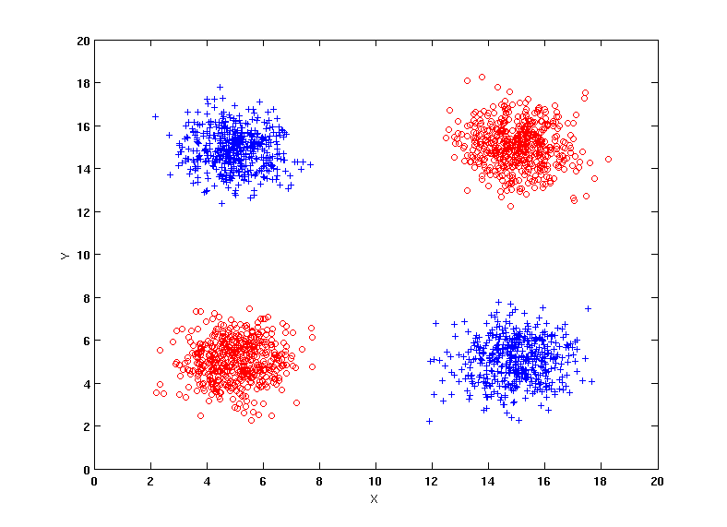
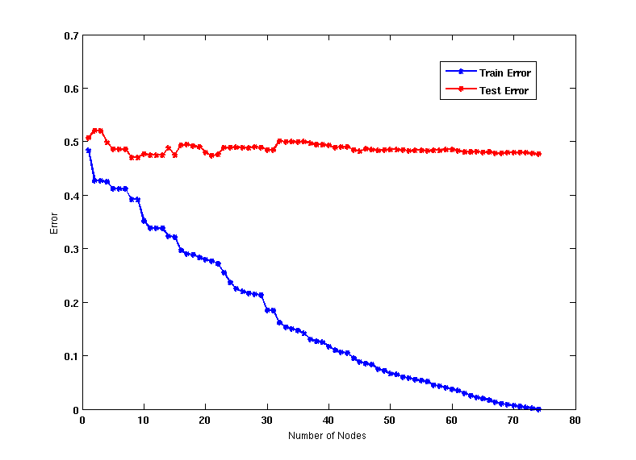
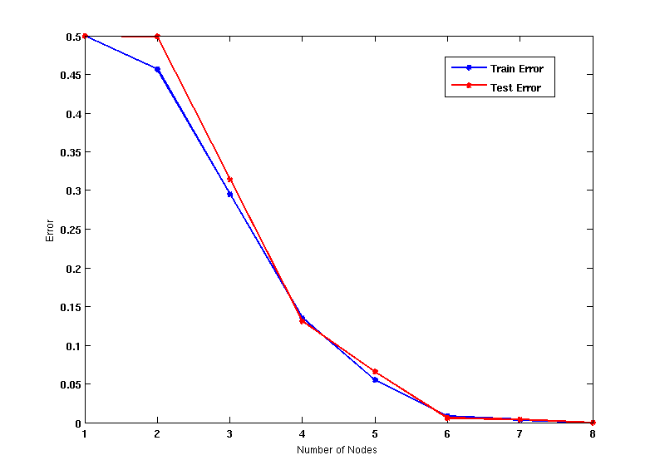
Effect of Multiple Comparison - Example
Use additional 100 noisy variables generated from a uniform distribution along with X and Y as attributes.
Use 30% of the data for training and 70% of the data for testing
Using only X and Y as attributes

Slide 79
Notes on Overfitting
Overfitting results in decision trees that are more complex than necessary
Training error does not provide a good estimate of how well the tree will perform on previously unseen records
Need ways for estimating generalization errors

Slide 80
Model Selection
Performed during model building
Purpose is to ensure that model is not overly complex (to avoid overfitting)
Need to estimate generalization error
Using Validation Set
Incorporating Model Complexity

Slide 81
Model Selection: Using Validation Set
Divide training data into two parts:
Training set:
use for model building
Validation set:
use for estimating generalization error
Note: validation set is not the same as test set
Drawback:
Less data available for training

Slide 82
Model Selection: Incorporating Model Complexity
Rationale: Occam’s Razor
Given two models of similar generalization errors, one should prefer the simpler model over the more complex model
A complex model has a greater chance of being fitted accidentally
Therefore, one should include model complexity when evaluating a model
Gen. Error(Model) = Train. Error(Model, Train. Data) +
x Complexity(Model)

Slide 83
Estimating the Complexity of Decision Trees
Pessimistic Error Estimate of decision tree T with k leaf nodes:
err(T): error rate on all training records
Ω: trade-off hyper-parameter (similar to )
Relative cost of adding a leaf node
k: number of leaf nodes
N_{train}: total number of training records

Slide 84
Estimating the Complexity of Decision Trees: Example
e(T_{L}) = 4/24
e(T_{R}) = 6/24
Ω = 1
e_{gen}(T_{L}) = 4/24 + 1*7/24 = 11/24 = 0.458
e_{gen}(T_{R}) = 6/24 + 1*4/24 = 10/24 = 0.417

Slide 85
Estimating the Complexity of Decision Trees
Resubstitution Estimate:
Using training error as an optimistic estimate of generalization error
Referred to as optimistic error estimate
e(T_{L}) = 4/24
e(T_{R}) = 6/24

Slide 86
Minimum Description Length (MDL)
Cost(Model,Data) = Cost(Data|Model) + x Cost(Model)
Cost is the number of bits needed for encoding.
Search for the least costly model.
Cost(Data|Model) encodes the misclassification errors.
Cost(Model) uses node encoding (number of children) plus splitting condition encoding.

Slide 87
Model Selection for Decision Trees
Pre-Pruning (Early Stopping Rule)
Stop the algorithm before it becomes a fully-grown tree
Typical stopping conditions for a node:
Stop if all instances belong to the same class
Stop if all the attribute values are the same
More restrictive conditions:
Stop if number of instances is less than some user-specified threshold
Stop if class distribution of instances are independent of the available features (e.g., using χ ² test)
Stop if expanding the current node does not improve impurity measures (e.g., Gini or information gain).
Stop if estimated generalization error falls below certain threshold

Slide 88
Model Selection for Decision Trees
Post-pruning
Grow decision tree to its entirety
Subtree replacement
Trim the nodes of the decision tree in a bottom-up fashion
If generalization error improves after trimming, replace sub-tree by a leaf node
Class label of leaf node is determined from majority class of instances in the sub-tree

Slide 89
Example of Post-Pruning
Training Error (Before splitting) = 10/30
Pessimistic error = (10 + 0.5)/30 = 10.5/30
Training Error (After splitting) = 9/30
Pessimistic error (After splitting)
= (9 + 4 × 0.5)/30 = 11/30
PRUNE!
Class = Yes | 20
Class = No | 10
Error = 10/30
Class = Yes | 8
Class = No | 4
Class = Yes | 3
Class = No | 4
Class = Yes | 4
Class = No | 1
Class = Yes | 5
Class = No | 1

Slide 90
Examples of Post-pruning

Slide 91
Model Evaluation
Purpose:
To estimate performance of classifier on previously unseen data (test set)
Holdout
Reserve k% for training and (100-k)% for testing
Random subsampling: repeated holdout
Cross validation
Partition data into k disjoint subsets
k-fold: train on k-1 partitions, test on the remaining one
Leave-one-out: k=n

Slide 92
Cross-validation Example
3-fold cross-validation

Slide 93
Variations on Cross-validation
Repeated cross-validation
Perform cross-validation a number of times
Gives an estimate of the variance of the generalization error
Stratified cross-validation
Guarantee the same percentage of class labels in training and test
Important when classes are imbalanced and the sample is small
Use nested cross-validation approach for model selection and evaluation

